Slide 1
Java for FTC
Session 3: Class Structure and Basic Driving

Slide 2
Overview
Code Organization and Best Practices
Session 2 Project
Motor Control Fundamentals
Your First Driving Robot
Working with Servos

Slide 3
Code Organization and Best Practices
Do it right or don’t do it

Slide 4
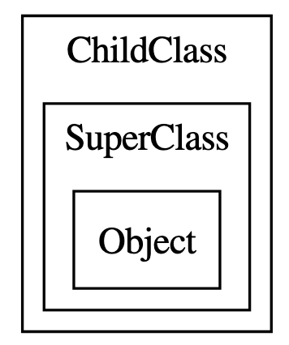
Inheritance
In Java, when you create a class it always “inherits” from a class.
If you don’t use the extends keyword then it is inheriting from the Object class in Java.
You can think about inheritance as your new class containing all of the super class (parent) plus any new content.
If you have a class method with the exact same name and parameters, then it will replace it.
You should put an @Override annotation on it so that everyone knows that was intentional
Code Organization and Best Practices

Slide 5
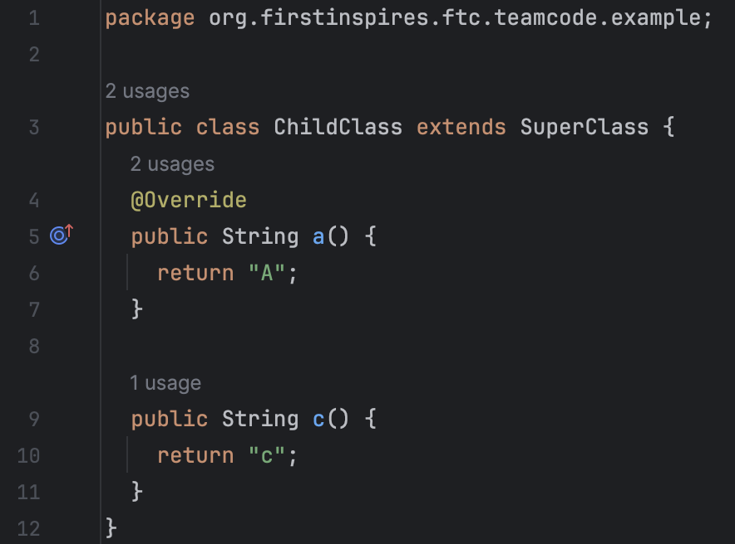
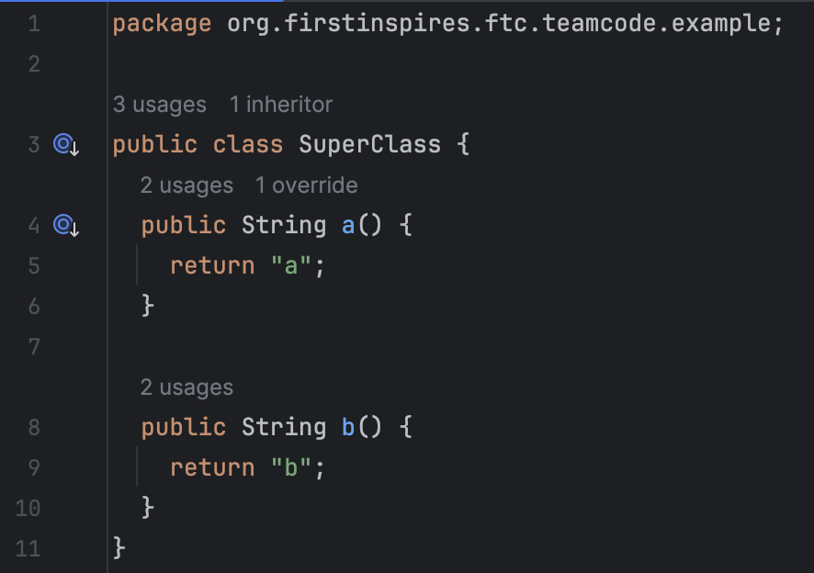
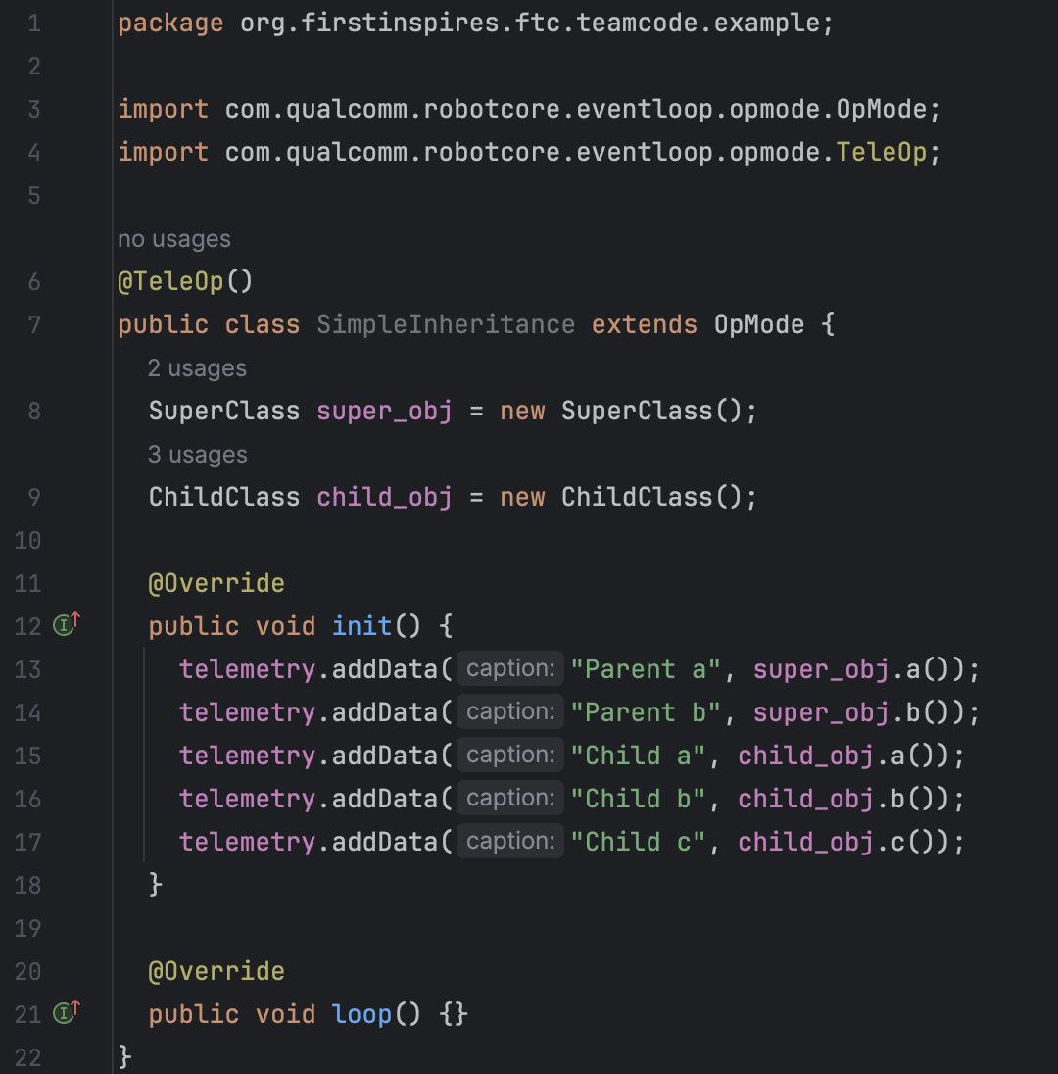
Inheritance
Can you guess what will show up on the telemetry screen?
Code Organization and Best Practices

Slide 6
Inheritance
Parent a: a
Parent b: b
Child a: A
Child b: b
Child c: c
Code Organization and Best Practices

Slide 7
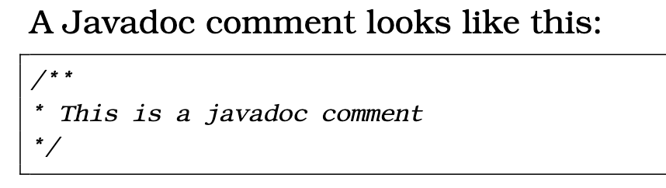
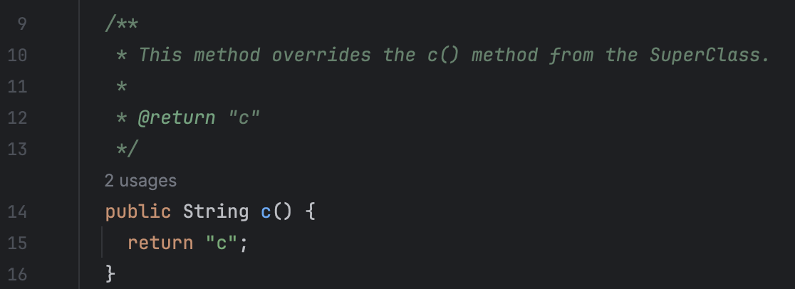
Javadoc and proper documentation
Why to use:
1. Android Studio will pick it up and give help to people using your classes
2. Autogenerating documentation that will amaze the judges
Use auto-complete because
that’s hella ugly
Code Organization and Best Practices

Slide 8
Session 2 Project

Slide 9
Creating a gamepad test program
Can you do the following?
Add telemetry to show the right stick of gamepad1.
Add telemetry to show whether the b button is pressed on gamepad1.
Report to the user the difference between the left joystick y and the right joystick y on gamepad1.
Report to the user the sum of the left and right triggers on gamepad1.
Building Your First Interactive Program

Slide 10
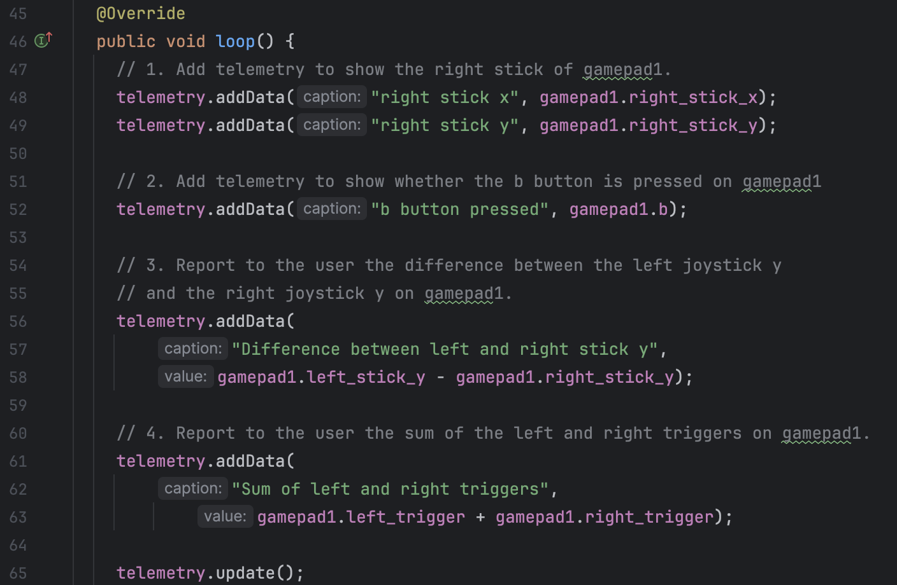
(Answers) Creating a gamepad test program
Building Your First Interactive Program

Slide 11
Motor Control Fundamentals
We start is less then an hour! ☹

Slide 12
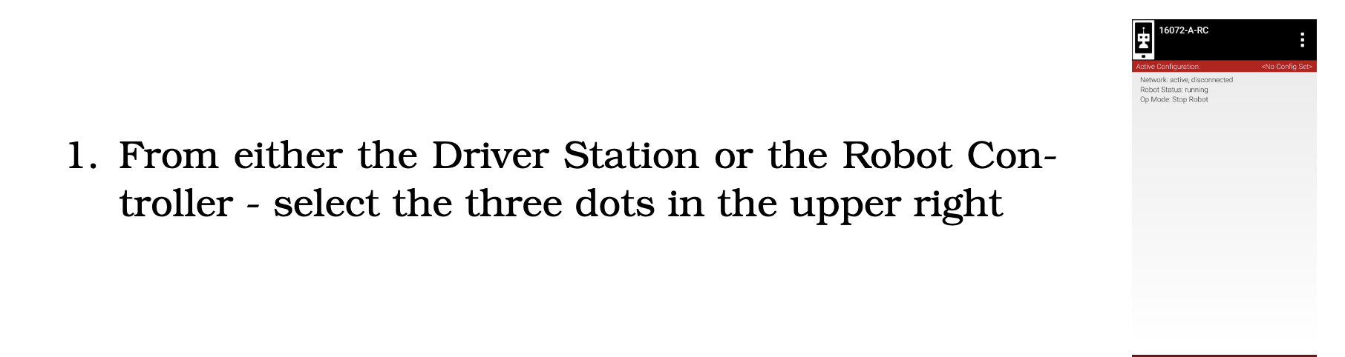
Adding a motor
Motor Control Fundamentals

Slide 13
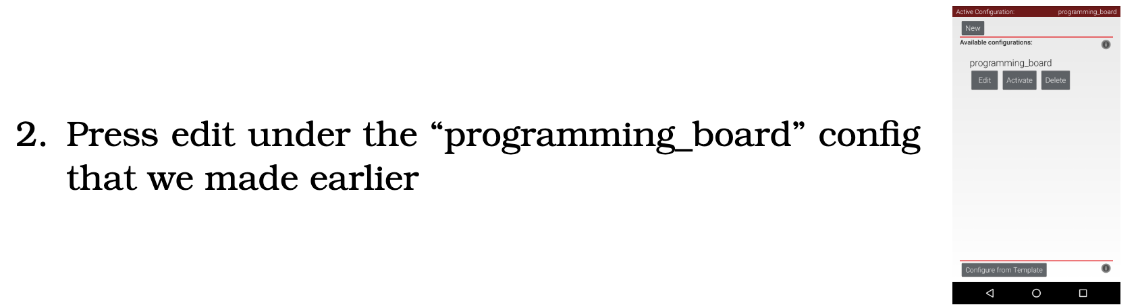
Adding a motor
Motor Control Fundamentals

Slide 14
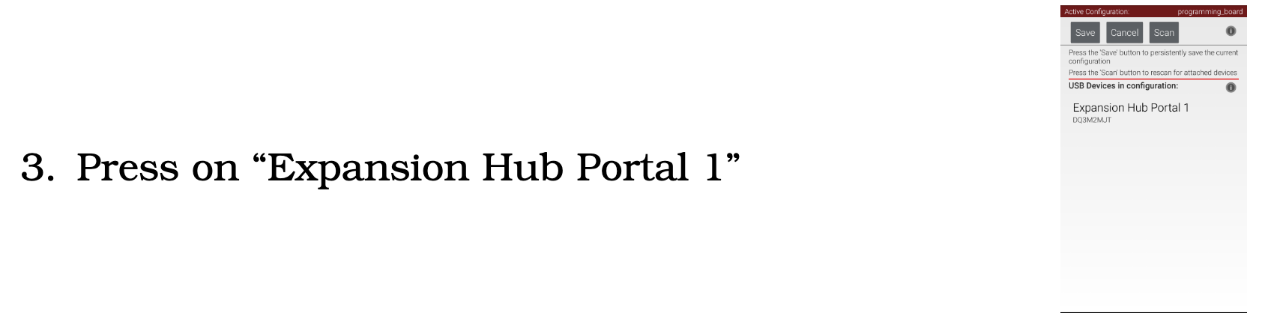
Adding a motor
Motor Control Fundamentals

Slide 15
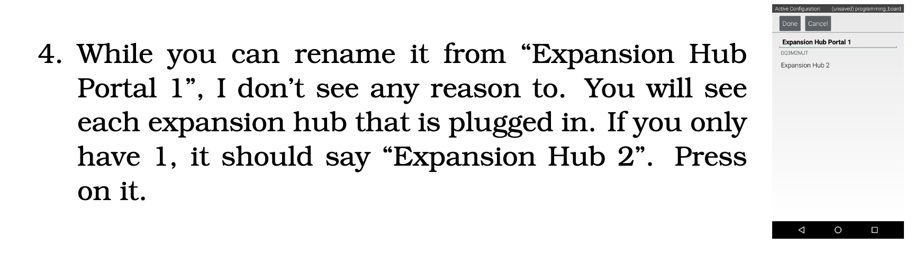
Adding a motor
Motor Control Fundamentals

Slide 16
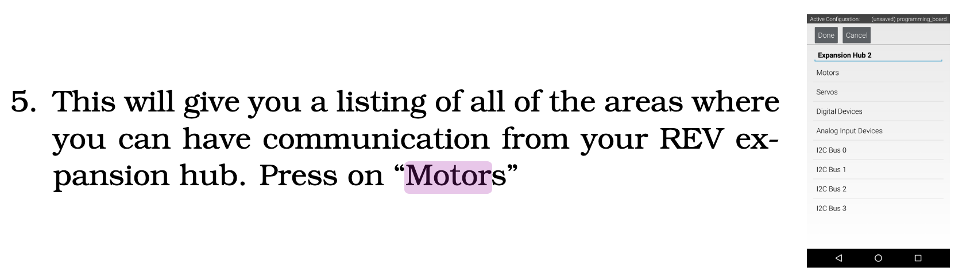
Adding a motor
Motor Control Fundamentals

Slide 17
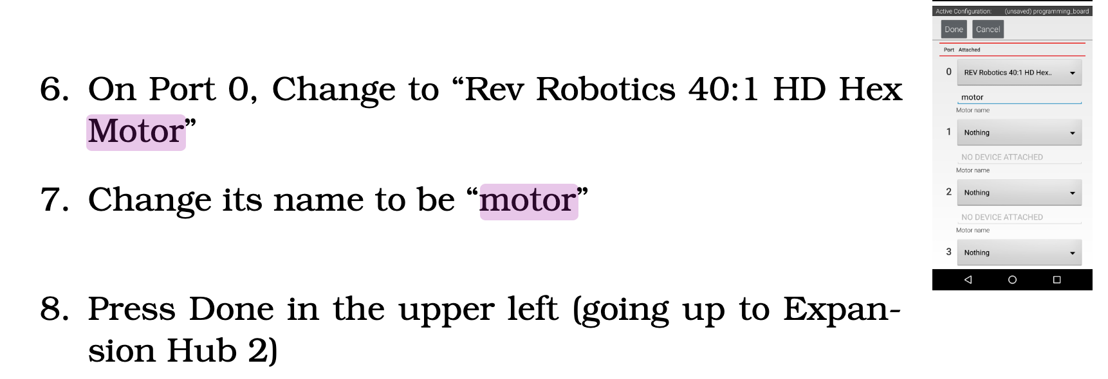
Adding a motor
Motor Control Fundamentals

Slide 18
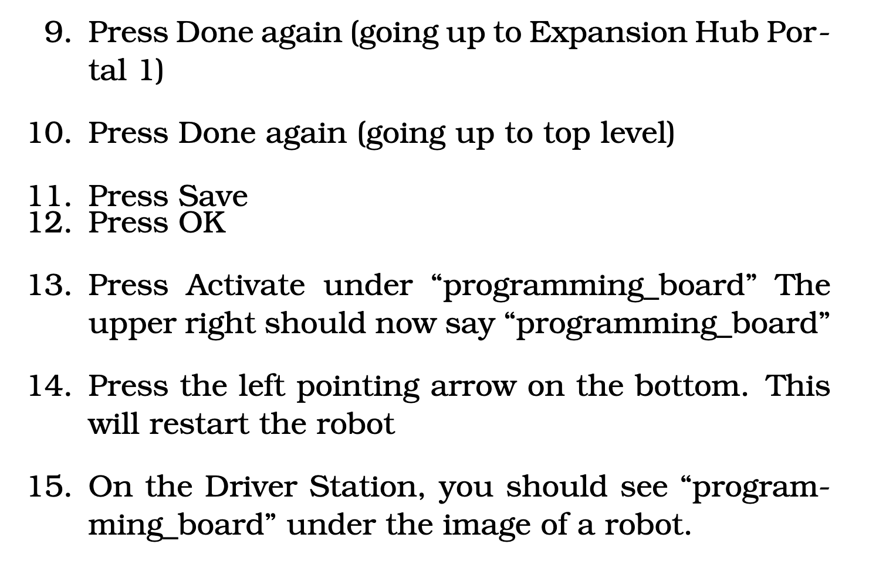
Adding a motor
Motor Control Fundamentals

Slide 19
Adding a motor
Motor Control Fundamentals

Slide 20
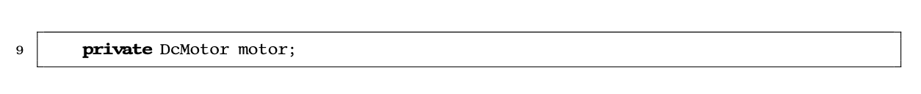
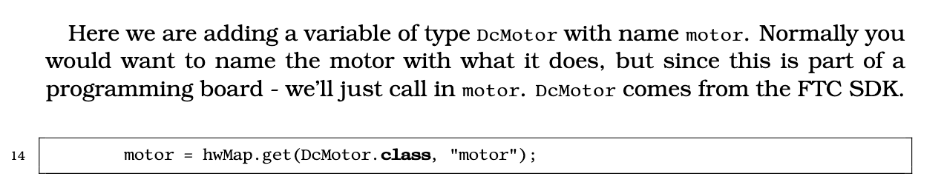
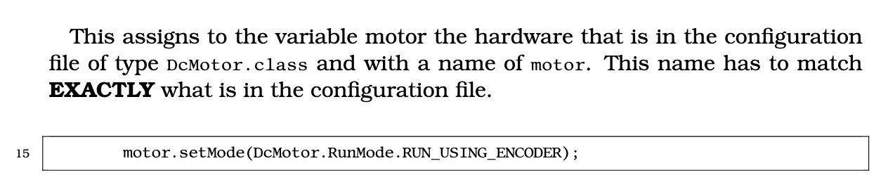
The DcMotor class
The class variable:
In init(): Note: this should NEVER be in loop()
Motor Control Fundamentals

Slide 21
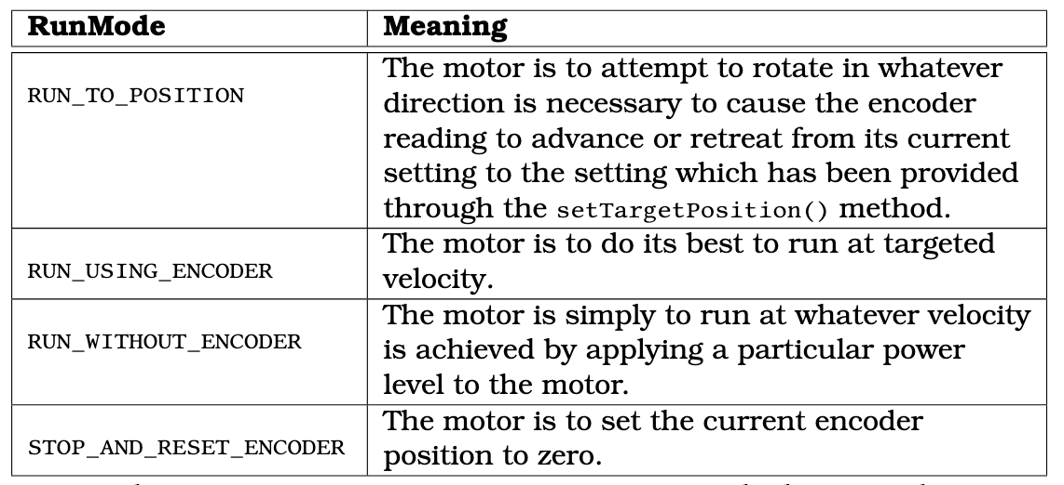
The DcMotor class
Ideal →
2nd Ideal →
… So on
Motor Control Fundamentals

Slide 22
The DcMotor class
Ideal →
Also Ideal →
← We like this mode because if you set two motors to the same speed then they have a better chance at being at the same speed than in any other mode.
Not as ideal
Motor Control Fundamentals

Slide 23
The DcMotor class
Should we use this for driving??
Why or why not?
Motor Control Fundamentals

Slide 24
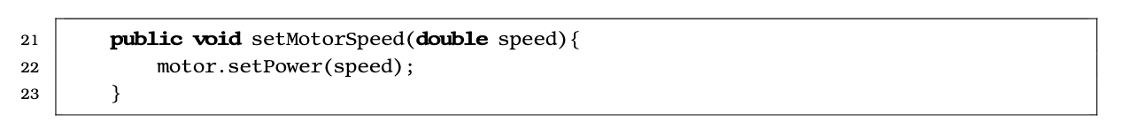
The DcMotor class
What’s the range? What do the values mean/do?
Motor Control Fundamentals

Slide 25
The DcMotor class
What’s the range? What do the values mean/do?
Motor Control Fundamentals

Slide 26
A program
Can you make an OP Mode that will run the frontLeftMotor at the speed of gampad1’s left Y stick?
Hint:
frontLeftMotor = hardwareMap.dcMotor.get("front_left_motor");
Motor Control Fundamentals

Slide 27
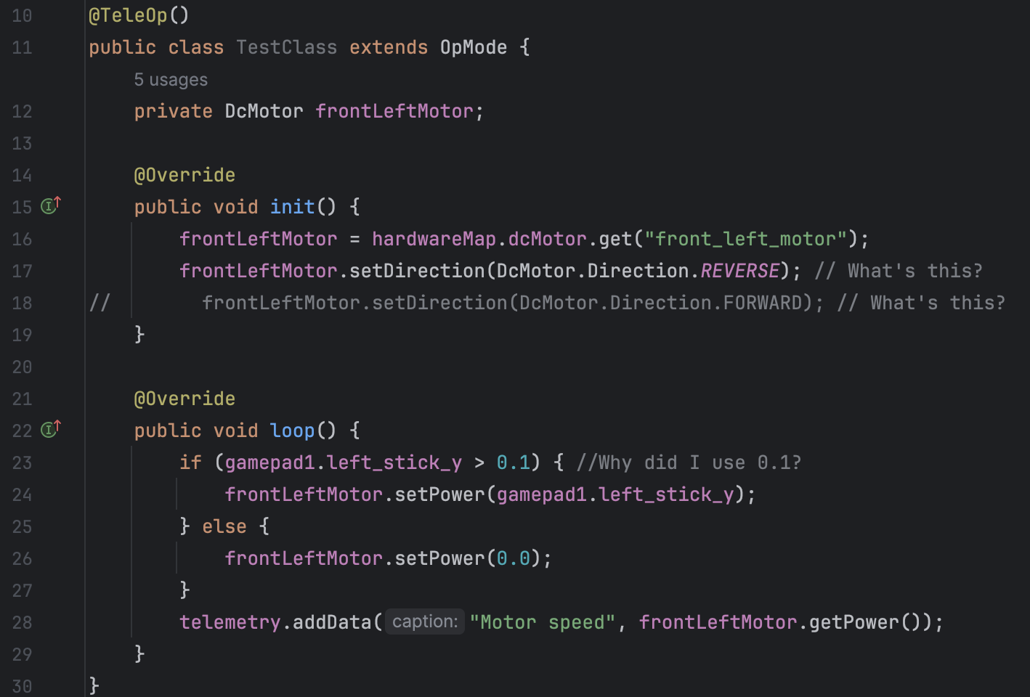
A program
Note that in Robot container you should usually not affect motors directly
Motor Control Fundamentals

Slide 28
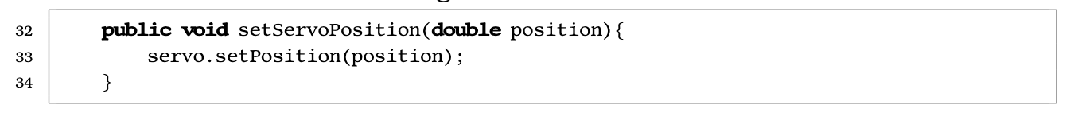
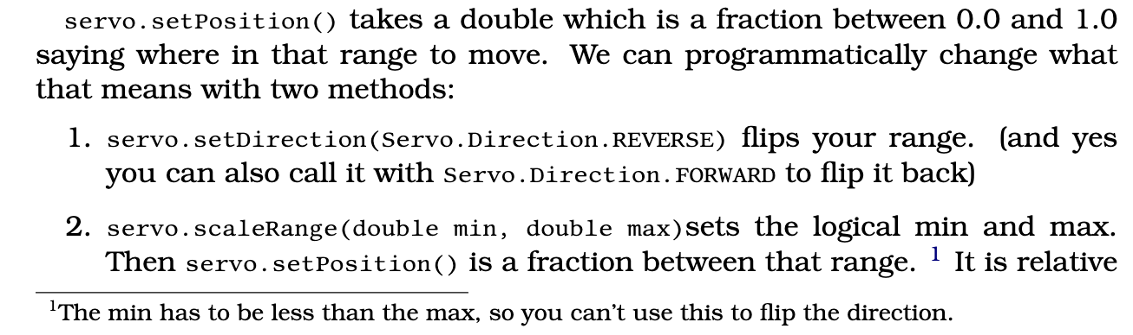
Servo in 30 seconds (Don’t time me)
Servos are essentially the same as motors (but small)
They use the “Servo” class and you call servo.setPosition(double)
Note:
For continuous servos + is clockwise and – counterclockwise.
0 is stop.
Motor Control Fundamentals

Slide 29
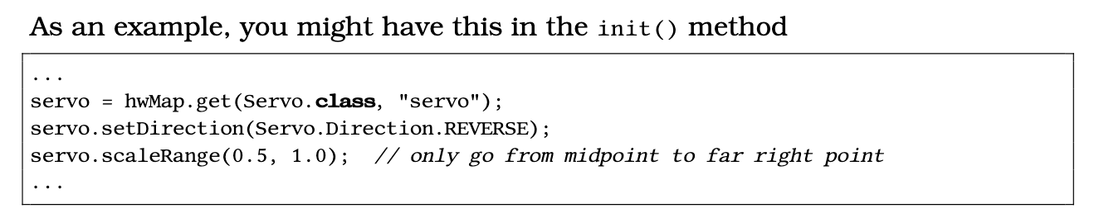
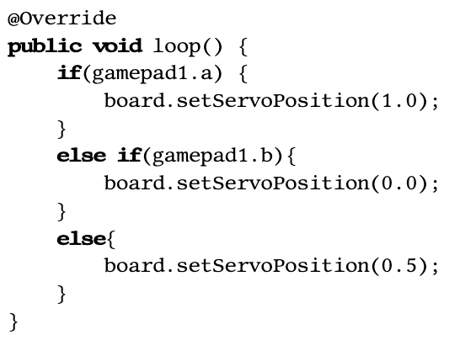
Servo in 30 seconds
Chains :O →
Motor Control Fundamentals

Slide 30
Making a Robot Oriented Drive!

Slide 31
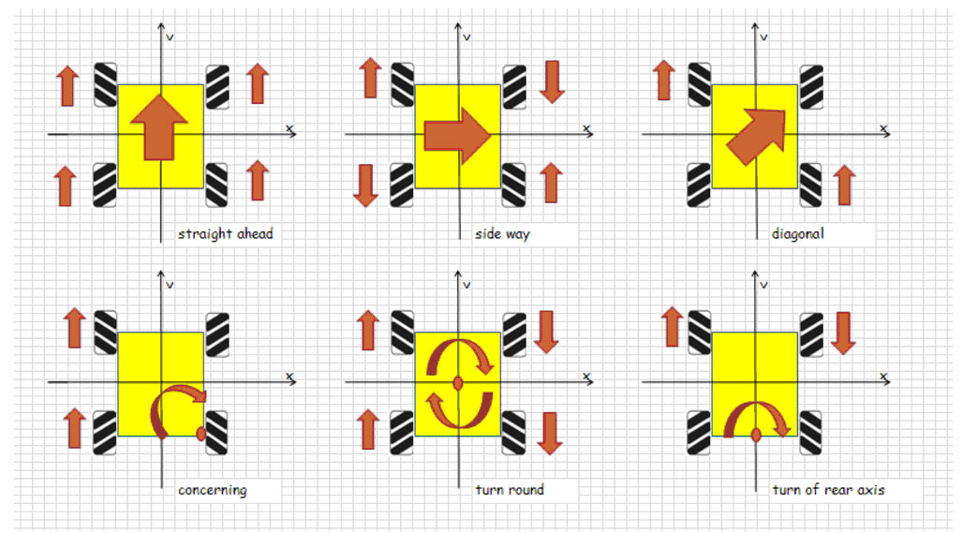
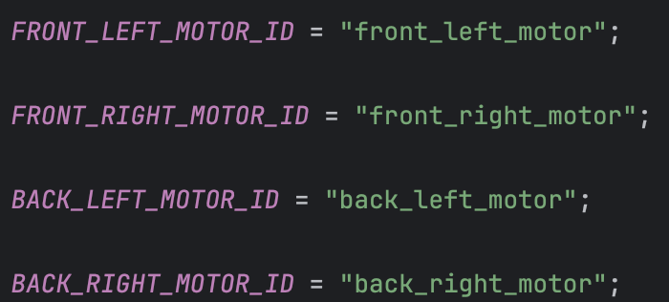
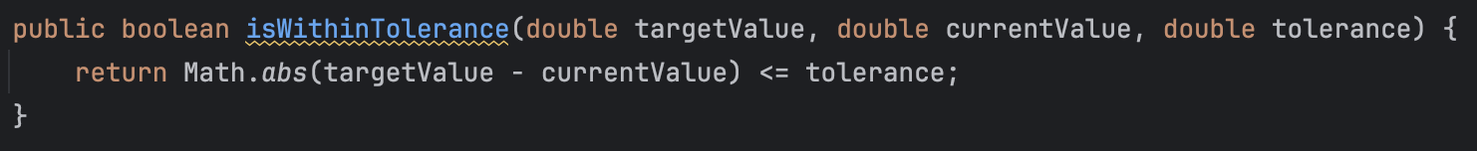
Do it.
That’s all ☺
We’ll talk about practice and a constants file after.
(Reverse frontLeftMotor)
This might also help
→

Slide 32
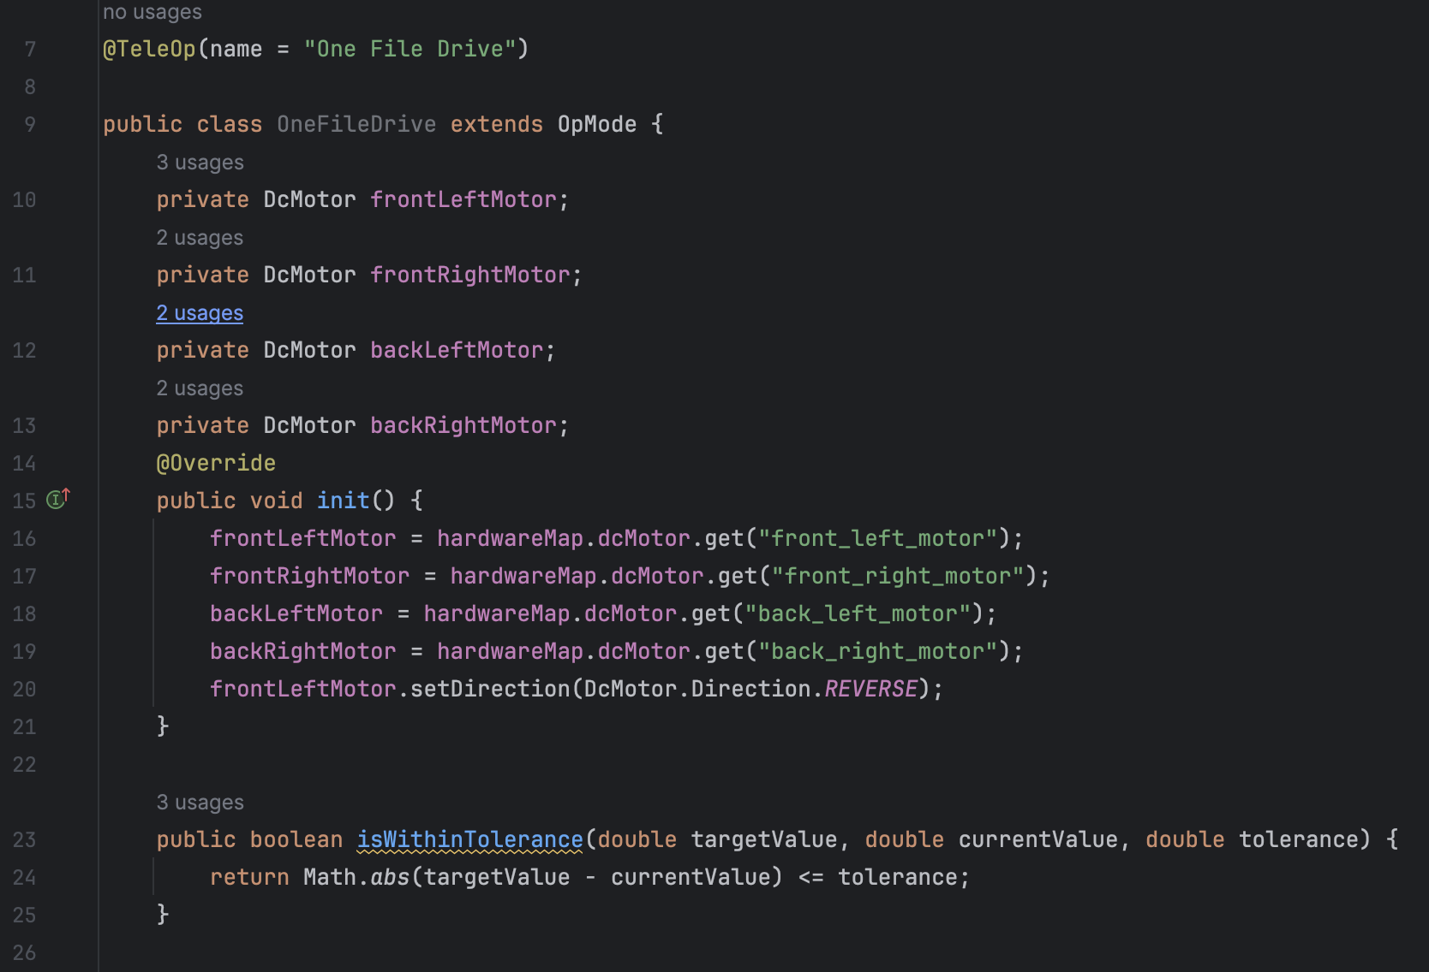
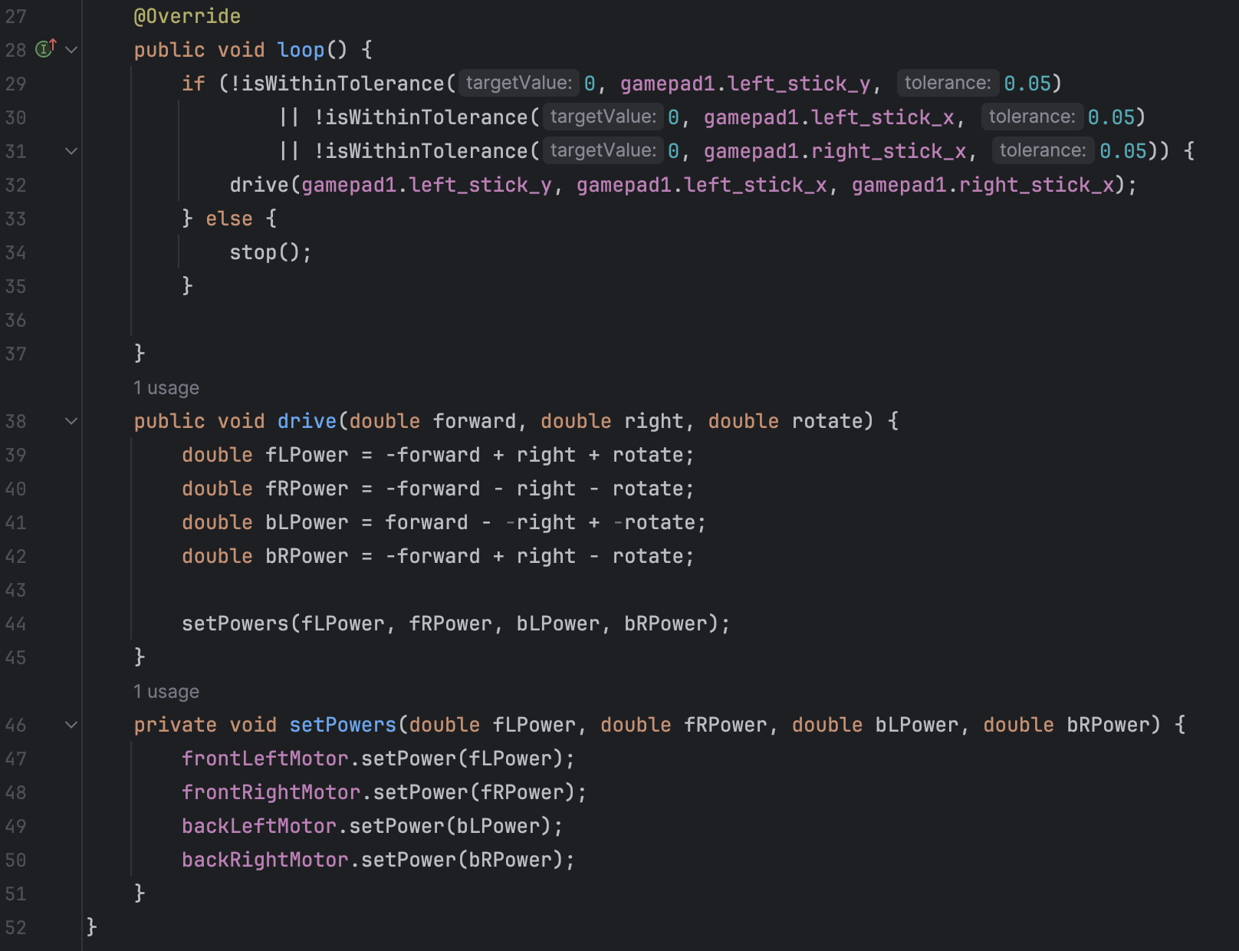
One file solution (worse but you haven’t really learned what’s better yet)
← Should call setPowers with all 0

Slide 33
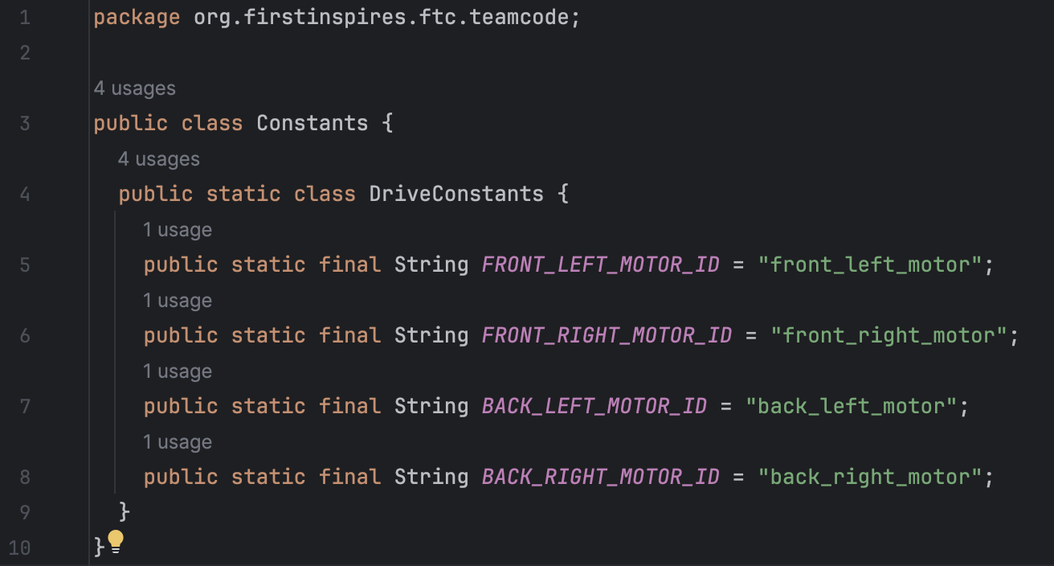
Multi file solution – Constants.java

Slide 34
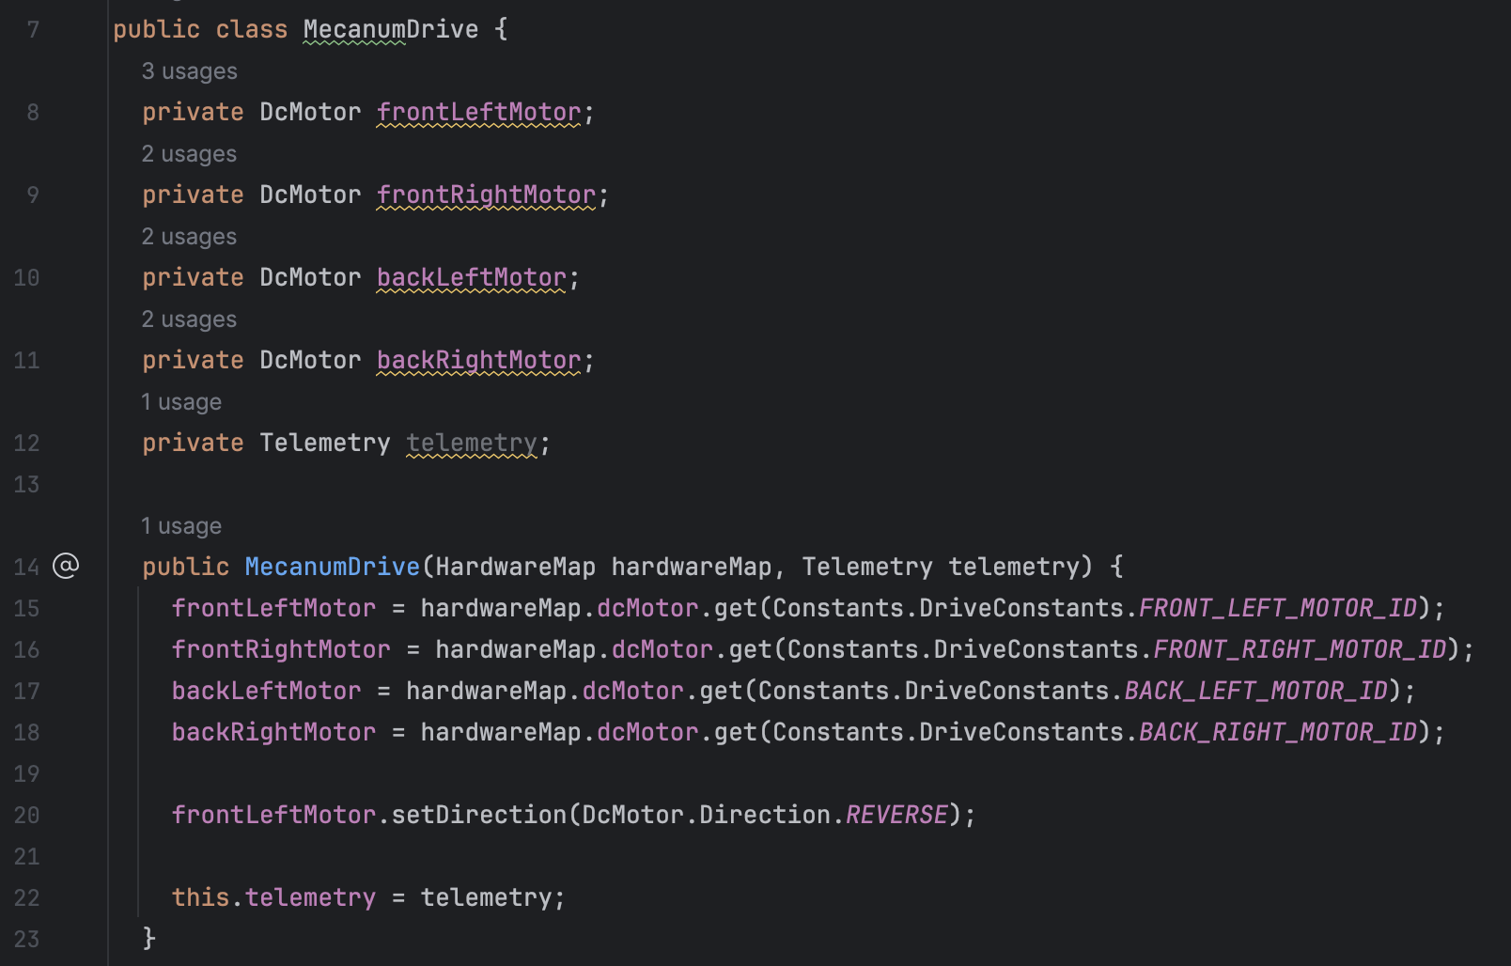
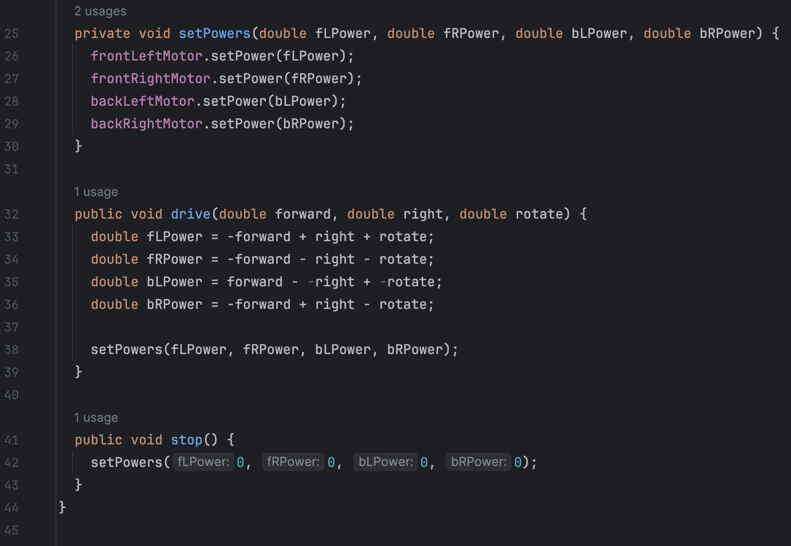
Multi file solution – MechanumDrive.java

Slide 35
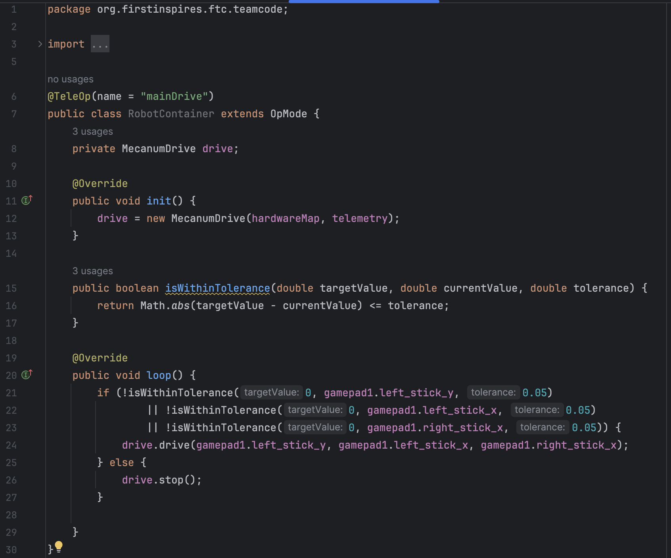
Multi file solution – RobotContainer.java

